Slide 1
UNIT 2 Relational Model and Relational Algebra

Slide 2
Relational Model Concepts
Domain: A (usually named) set/universe of atomic values, where by "atomic" we mean simply that, from the point of view of the database, each value in the domain is indivisible (i.e., cannot be broken down into component parts).
Examples of domains
SSN: string of digits of length nine
Name: string of characters beginning with an upper case letter
Attribute: the name of the role played by some value (coming from some domain) in the context of a relational schema. The domain of attribute A is denoted dom(A).
Tuple: A tuple is a mapping from attributes to values drawn from the respective domains of those attributes. A tuple is intended to describe some entity (or relationship between entities) in the mini world.
As an example, a tuple for a PERSON entity might be
{Name → "John", Gender → Male, IQ → 143 }

Slide 3
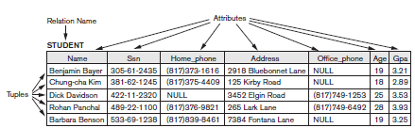
Relational Model Concepts
Relation: A (named) set of tuples all of the same form (i.e., having the same set of attributes). The term table is a loose synonym. (Some database purists would argue that a table is "only" a physical manifestation of a relation.)
Relational Schema: used for describing (the structure of) a relation. E.g., R(A₁, A₂, ..., A_{n}) says that R is a relation with attributes A₁, ... A_{n}. The degree of a relation is the number of attributes it has, here n.
Example: STUDENT (Name, SSN, Address)
Relational Database: A collection of relations, each one consistent with its specified relational schema.

Slide 4
Characteristics of Relations
Ordering of Tuples: A relation is a set of tuples; hence, there is no order associated with them. That is, it makes no sense to refer to, for example, the 5th tuple in a relation. When a relation is depicted as a table, the tuples are necessarily listed in some order, of course, but you should attach no significance to that order. Similarly, when tuples are represented on a storage device, they must be organized in some fashion, and it may be advantageous, from a performance standpoint, to organize them in a way that depends upon their content.
Ordering of Attributes: A tuple is best viewed as a mapping from its attributes (i.e., the names we give to the roles played by the values comprising the tuple) to the corresponding values. Hence, the order in which the attributes are listed in a table is irrelevant.
Values of Attributes: For a relation to be in First Normal Form, each of its attribute domains must consist of atomic (neither composite nor multi-valued) values. Much of the theory underlying the relational model was based upon this assumption.
Interpretation of a Relation: Each relation can be viewed as a predicate and each tuple in that relation can be viewed as an assertion for which that predicate is satisfied (i.e., has value true) for the combination of values in it. In other words, each tuple represents a fact.

Slide 5
Relational Model Notation
R(A₁, A₂, ..., A_{n}) is a relational schema of degree n denoting that there is a relation R having as its attributes A₁, A₂, ..., A_{n}.
By convention, Q, R, and S denote relation names.
By convention, q, r, and s denote relation states. For example, r(R) denotes one possible state of relation R. If R is understood from context, this could be written, more simply, as r.
By convention, t, u, and v denote tuples.
The "dot notation" R.A (e.g., STUDENT.Name) is used to qualify an attribute name, usually for the purpose of distinguishing it from a same-named attribute in a different relation
(e.g., DEPARTMENT.Name).

Slide 6
Relational Model Constraints and Relational Database Schemas
Constraints on databases can be categorized as follows:
Inherent model-based: Example: no two tuples in a relation can be duplicates (because a relation is a set of tuples)
Schema-based: Can be expressed using DDL;
Application-based: Are specific to the "business rules" of the mini world and typically difficult or impossible to express and enforce within the data model. Hence, it is left to application programs to enforce.
Elaborating upon schema-based constraints:
Domain Constraints: Each attribute value must be either null (which is really a non-value) or drawn from the domain of that attribute. Note that some DBMS's allow you to impose the not null constraint upon an attribute, which is to say that that attribute may not have the (non-)value null.

Slide 7
Relational Model Constraints and Relational Database Schemas
Key Constraints: A relation is a set of tuples, and each tuple's "identity" is given by the values of its attributes. Hence, it makes no sense for two tuples in a relation to be identical (because then the two tuples are actually one and the same tuple). That is, no two tuples may have the same combination of values in their attributes.
A key k of a relation schema R is a superkey of R with the additional property that removing any attribute A from K leaves a set of attributes K′ that is not a superkey of R any more. Hence, a key satisfies two properties:
1. Two distinct tuples in any state of the relation cannot have identical values for (all) the attributes in the key. This uniqueness property also applies to a superkey.
2. It is a minimal superkey—that is, a superkey from which we cannot remove any attributes and still have the uniqueness constraint hold. This minimality property is required for a key but is optional for a superkey.
Candidate key: a relation schema may have more than one key. In this case, each of the keys is called a candidate key. It is common to designate one of the candidate keys as the primary key of the relation.
Primary key: a key chosen to act as the means by which to identify tuples in a relation. Typically, one prefers a primary key to be one having as few attributes as possible.

Slide 8
Relational Database Schemas
A relational database schema S is a set of relation schemas S = {R₁, R₂, … , R_{m}} and a set of integrity constraints (IC).
A relational database state DB of S is a set of relation states DB = {r₁, r₂, … , r_{m}} such that each r_{i} is a state of R_{i} and such that the r_{i} relation states satisfy the integrity constraints specified in IC.
OR
A relational database state/instance/snapshot is a set of states of its relations such that no integrity constraint is violated.
Entity Integrity, Referential Integrity, and Foreign Keys:
The entity integrity constraint states that no primary key value can be NULL. This is because the primary key value is used to identify individual tuples in a relation. Having NULL values for the primary key implies that we cannot identify some tuples.
The referential integrity constraint is specified between two relations and is used to maintain the consistency among tuples in the two relations. Informally, the referential integrity constraint states that a tuple in one relation that refers to another relation must refer to an existing tuple in that relation.

Slide 9
Relational Database Schemas
Foreign key : A set of attributes FK in relation schema R1 is a Foreign key of R1 that references relation R2 if it satisfies the following rules:
1. The attributes in FK have the same domain(s) as the primary key attributes PK of R2; the attributes FK are said to reference or refer to the relation R2.
2. A value of FK in a tuple t1 of the current state r1(R1) either occurs as a value of PK for some tuple t2 in the current state r2(R2) or is NULL. In the former case, we have t1[FK] = t2[PK], and we say that the tuple t1 references or refers to the tuple t2.
Semantic Integrity Constraints: application-specific restrictions those are unlikely to be expressible in DDL. Examples:
Salary of a supervisee cannot be greater than that of her/his supervisor
Salary of an employee cannot be lowered

Slide 10
Update Operations , Transactions, and Dealing with Constraint Violations
For each of the update operations (Insert, Delete, and Update), we consider what kinds of constraint violations may result from applying it and how we might choose to react.
The Insert Operation: The Insert operation provides a list of attribute values for a new tuple t that is to be inserted into a relation R. Insert can violate any of the four types of constraints.
Domain constraints can be violated if an attribute value is given that does not appear in the corresponding domain or is not of the appropriate data type.
Key constraints can be violated if a key value in the new tuple t already exists in another tuple in the relation r(R).
Entity integrity can be violated if any part of the primary key of the new tuple t is NULL.
Referential integrity can be violated if the value of any foreign key in t refers to a tuple that does not exist in the referenced relation.
Ways of dealing with it:
If an insertion violates one or more constraints, the default option is to reject the insertion.
Give user opportunity to try again with different attribute values.

Slide 11
Update Operations , Transactions, and Dealing with Constraint Violations
The Delete Operation: The Delete operation can violate only referential integrity constraint. This occurs if the tuple being deleted is referenced by foreign keys from other tuples in the database.
Ways of dealing with it: Several options are available if a deletion operation causes a violation.
The first option, called restrict, is to reject the deletion.
The second option, called cascade, is to attempt to cascade (or propagate) the deletion by deleting tuples that reference the tuple that is being deleted.
The third option, called set null or set default, is to modify the referencing attribute values that cause the violation; each such value is either set to NULL or changed to reference another default valid tuple.
Combinations of these three options are also possible.

Slide 12
Update Operations , Transactions, and Dealing with Constraint Violations
The Update Operation: The Update (or Modify) operation is used to change the values of one or more attributes in a tuple (or tuples) of some relation R. It is necessary to specify a condition on the attributes of the relation to select the tuple (or tuples) to be modified.
Key constraint violation: The primary key is changed so as to become same as another tuple‘s key.
Referential integrity violation:
Foreign key is changed and new one refers to nonexistent tuple.
Primary key is changed and now other tuples that had referred to this one violate the constraint.
Ways of dealing with it: Modifying a primary key value is similar to deleting one tuple and inserting another in its place because we use the primary key to identify tuples. Hence, the solutions discussed with INSERT operation & DELETE operation are used to deal with Update Operation.

Slide 13
Update Operations , Transactions, and Dealing with Constraint Violations
The Transaction Concept:
A transaction is an executing program (logical unit of work) that includes some database operations, such as reading from the database, or applying insertions, deletions, or updates to the database. (such as what might be required to reserve several seats on an airplane flight).
At the end of the transaction, it must leave the database in a valid or consistent state that satisfies all the constraints specified on the database schema.
This concept is relevant in the context where multiple users and/or application programs are accessing and updating the database concurrently.
The point is that, even though several transactions might be processed concurrently, the end result must be as though the transactions were carried out sequentially. (Example of simultaneous withdrawals from same checking account.)

Slide 14
Relational Algebra
The basic set of operations for the formal relational model is the relational algebra.
The algebra operations produce new relations, which can be further manipulated using operations of the same algebra.
A sequence of relational algebra operations forms a relational algebra expression, whose result will also be a relation that represents the result of a database query.
Unary Relational Operations:
SELECT and PROJECT
The SELECT Operation: It is denoted by the symbol σ (sigma)
The SELECT operation is used to choose a subset of the tuples from a relation that satisfies a selection condition. We can consider the SELECT operation to be a filter that keeps only those tuples that satisfy a qualifying condition.
The SELECT operation can also be visualized as a horizontal partition of the relation into two sets of tuples—those tuples that satisfy the condition and are selected, and those tuples that do not satisfy the condition and are filtered out.

Slide 15
Relational Algebra - The SELECT Operation
For example:
1. To select the EMPLOYEE tuples whose department is 4
σ_{Dno=4}(EMPLOYEE)
2. To select the EMPLOYEE tuples of those whose salary is greater than $30,000.
σ_{Salary>30000}(EMPLOYEE)
The symbol σ (sigma) is used to denote the SELECT operator and the selection
condition is a Boolean expression (condition) specified on the attributes of
relation R. The Boolean expression specified in <selection condition> is made up of a number of clauses of the form
<attribute name> <comparison op> <constant value>
or
<attribute name> <comparison op> <attribute name>
where <attribute name> is the name of an attribute of R, <comparison op> is normally one of the operators {=, <, ≤, >, ≥, ≠}, and <constant value> is a constant value from the attribute domain. Clauses can be connected by the standard Boolean operators and, or, and not to form a general selection condition.

Slide 16

Relational Algebra - The SELECT Operation
For example, to select the tuples for all employees who either work in department 4 and make over $25,000 per year, or work in department 5 and make over $30,000, we can specify the following SELECT operation:
σ(Dno=4 AND Salary>25000) OR (Dno=5 AND Salary>30000)(EMPLOYEE)
The result is shown below
The SELECT operator is unary; that is, it is applied to a single relation. Moreover, the selection operation is applied to each tuple individually; hence, selection conditions cannot involve more than one tuple. The degree of the relation resulting from a SELECT operation—its number of attributes—is the same as the degree of R. The number of tuples in the resulting relation is always less than or equal to the number of tuples in R.

Slide 17
Relational Algebra - The SELECT Operation
The SELECT operation is commutative, that is,
σ_{<cond1>}(σ_{<cond2>}(R)) = σ_{<cond2>}(σ_{<cond1>}(R))
In SQL, the SELECT condition is typically specified in the WHERE clause of a query. For example, the following operation:
σ_{Dno=4 AND Salary>25000} (EMPLOYEE)
would correspond to the following SQL query:
SELECT *
FROM EMPLOYEE
WHERE Dno=4 AND Salary>25000;

Slide 18
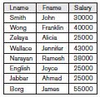
Relational Algebra - The PROJECT Operation
The PROJECT operation: It is denoted by the symbol π (Pi)
The Project operation selects certain columns from the table and discards the other columns. If we are interested in only certain attributes of a relation, we use the PROJECT operation to project the relation over these attributes only.
Therefore, the result of the PROJECT operation can be visualized as a vertical partition of the relation into two relations: one has the needed columns attributes) and contains the result of the operation, and the other contains the discarded columns.
For example, to list each employee’s first and last name and salary, we can use the PROJECT operation as follows:
π_{Lname, Fname, Salary}(EMPLOYEE)
The result of the above relational algebra query is shown here.

Slide 19
Relational Algebra - The PROJECT Operation
The general form of the PROJECT operation is
π_{<attribute list>}(R)
where π (pi) is the symbol used to represent the PROJECT operation, and <attribute list> is the desired sub-list of attributes from the attributes of relation R. Again, notice that R is, in general, a relational algebra expression whose result is a relation, which in the simplest case is just the name of a database relation.
The result of the PROJECT operation has only the attributes specified in <attribute list> in the same order as they appear in the list. Hence, its degree is equal to the number of attributes in <attribute list>.
The PROJECT operation removes any duplicate tuples, so the result of the PROJECT operation is a set of distinct tuples.
In SQL, the PROJECT attribute list is specified in the SELECT clause of a query. For example, the following operation:
π_{Age, Salary}(EMPLOYEE)
would correspond to the following SQL query:
SELECT DISTINCT Age, Salary
FROM EMPLOYEE;

Slide 20

Sequences of Operations and the RENAME Operation
Usually, for most queries, we need to apply several relational algebra operations one after the other. Either we can write the operations as a single relational algebra expression by nesting the operations, or we can apply one operation at a time and create intermediate result relations. In the latter case, we must give names to the relations that hold the intermediate results.
For example, to retrieve the first name, last name, and salary of all employees who work in department number 5, we must apply a SELECT and a PROJECT operation. We can write a single relational algebra expression, also known as an in-line expression, as follows:
π_{Fname, Lname, Salary}(σ_{Dno=5}(EMPLOYEE))

Slide 21
Sequences of Operations and the RENAME Operation
Alternatively, we can explicitly show the sequence of operations, giving a name to each intermediate relation, and using the assignment operation, denoted by ← (left arrow), as follows:
DEPT5_EMPS ← σ_{Dno=5}(EMPLOYEE)
RESULT ← π_{Fname, Lname, Salary}(DEPT5_EMPS)
It is sometimes simpler to break down a complex sequence of operations by specifying intermediate result relations than to write a single relational algebra expression.

Slide 22
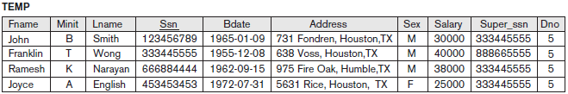
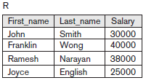
Sequences of Operations and the RENAME Operation
We can also use this technique to rename the attributes in the intermediate and result relations. This can be useful in connection with more complex operations such as UNION and JOIN, as we shall see. To rename the attributes in a relation, we simply list the new attribute names in parentheses, as in the following example:
TEMP ← σ_{Dno=5}(EMPLOYEE)
R(First_name, Last_name, Salary) ← π_{Fname, Lname, Salary}(TEMP)
The result of the above 2 relational algebra queries is shown below.

Slide 23
Sequences of Operations and the RENAME Operation
We can also define a formal RENAME operation—which can rename either the relation name or the attribute names, or both—as a unary operator. The general RENAME operation when applied to a relation R of degree n is denoted by any of the following three forms:
ρ_{S(B1, B2, ... , Bn)}(R)
or
ρ_{S}(R)
or
ρ_{(B1, B2, ... , Bn)}(R)
where the symbol ρ (rho) is used to denote the RENAME operator, S is the new relation name, and B1, B2, … , Bn are the new attribute names. The first expression renames both the relation and its attributes, the second renames the relation only, and the third renames the attributes only. If the attributes of R are (A1, A2, … , An) in that order, then each A_{i} is renamed as B_{i}.

Slide 24
Relational Algebra Operations from Set Theory
The UNION, INTERSECTION, and MINUS Operations
The next group of relational algebra operations are the standard mathematical operations on sets. We can define the three operations UNION, INTERSECTION, and SET DIFFERENCE on two union-compatible relations R and S as follows:
■ UNION: The result of this operation, denoted by R ∪ S, is a relation that includes all tuples that are either in R or in S or in both R and S. Duplicate tuples are eliminated.
■ INTERSECTION: The result of this operation, denoted by R ∩ S, is a relation that includes all tuples that are in both R and S.
■ SET DIFFERENCE (or MINUS): The result of this operation, denoted by R – S, is a relation that includes all tuples that are in R but not in S.

Slide 25
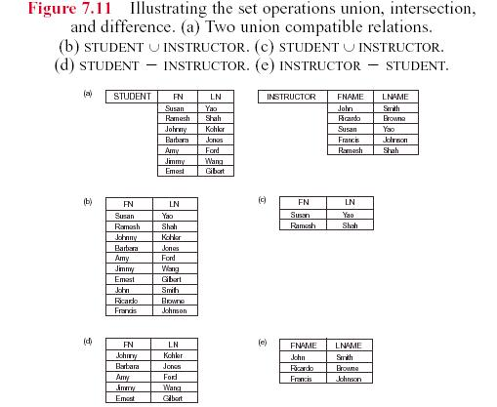
Relational Algebra Operations from Set Theory
The UNION, INTERSECTION, and MINUS Operations
For ∪, ∩, -, the operand relations R(A1, A2, ..., An) and S(B1, B2, ..., Bn) must have the same number of attributes, and the domains of corresponding attributes must be compatible; that is, dom(A_{i}) = dom(B_{i}) for i=1, 2, ..., n. This condition is called union compatibility. The resulting relation for ∪, ∩ or - has the same attribute names as the first operand relation R (by convention).

Slide 26
Relational Algebra Operations from Set Theory
The CARTESIAN PRODUCT / CROSS PRODUCT/ CROSS JOIN Operation
It is denoted by ×. This is also a binary set operation, but the relations on which it is applied do not have to be union compatible. In its binary form, this set operation produces a new element by combining every member (tuple) from one relation (set) with every member (tuple) from the other relation (set). In general, the result of R(A1, A2, … , An) × S(B1, B2, … , Bm) is a relation Q with degree n + m attributes Q(A1, A2, … , An, B1, B2, … , Bm), in that order.
The resulting relation Q has one tuple for each combination of tuples—one from R and one from S.
Example: Combine each DEPARTMENT tuple with the EMPLOYEE tuple of the manager.
DEP_EMP ← DEPARTMENT X EMPLOYEE
DEPT_MANAGER ← σ _{MGRSSN=SSN}(DEP_EMP)

Slide 27
Binary Relational Operations:
JOIN and DIVISION
The JOIN Operation: The JOIN operation, denoted by , is used to combine related tuples from two relations into single “longer” tuples. This operation is very important for any relational database with more than a single relation because it allows us to process relationships among relations.
To illustrate JOIN, suppose that we want to retrieve the name of the manager of each department. To get the manager’s name, we need to combine each department tuple with the employee tuple whose Ssn value matches the Mgr_ssn value in the department tuple. We do this by using the JOIN operation and then projecting the result over the necessary attributes, as follows:
DEPT_MGR ← DEPARTMENT _{Mgr_ssn=Ssn} EMPLOYEE
RESULT ← π_{Dname, Lname, Fname}(DEPT_MGR)
The general form of a JOIN operation on two relations R(A1, A2, … , An) and
S(B1, B2, … , Bm) is
R _{<join condition>}S

Slide 28
Binary Relational Operations:
JOIN and DIVISION
The result of the JOIN is a relation Q with n + m attributes Q(A1, A2, … , An, B1, B2,… , Bm) in that order; Q has one tuple for each combination of tuples—one from R and one from S—whenever the combination satisfies the join condition.
This is the main difference between CARTESIAN PRODUCT and JOIN. In JOIN, only combinations of tuples satisfying the join condition appear in the result, whereas in the CARTESIAN PRODUCT all combinations of tuples are included in the result. The join condition is specified on attributes from the two relations R and S and is evaluated for each combination of tuples. Each tuple combination for which the join condition evaluates to TRUE is included in the resulting relation Q as a single combined tuple.
INNER JOIN : THETA JOIN, EQUI JOIN & NATURAL JOIN
OUTER JOIN : LEFT OUTER JOIN, RIGHT OUTER JOIN & FULL OUTER JOIN

Slide 29
Binary Relational Operations:
JOIN and DIVISION
INNER JOIN : THETA JOIN, EQUI JOIN & NATURAL JOIN
THETA JOIN: A general join condition is of the form
<condition> AND <condition> AND … AND <condition>
where each <condition> is of the form A_{i} θ B_{j}, A_{i} is an attribute of R, B_{j} is an attribute of S, A_{i} and B_{j} have the same domain, and θ (theta) is one of the comparison operators {=, <, ≤, >, ≥, ≠}. A JOIN operation with such a general join condition is called a THETA JOIN.
EQUI JOIN: The most common use of JOIN involves join conditions with equality comparisons only. Such a JOIN, where the only comparison operator used is =, is called an EQUI JOIN.

Slide 30
Binary Relational Operations: JOIN and DIVISION
NATURAL JOIN: Denoted by *. NATURAL JOIN requires that the two join attributes (or each pair of join attributes) have the same name in both relations. If this is not the case, a renaming operation is applied first.
Suppose we want to combine each PROJECT tuple with the DEPARTMENT tuple that controls the project. In the following example, first we rename the Dnumber attribute of DEPARTMENT to Dnum—so that it has the same name as the Dnum attribute in PROJECT—and then we apply NATURAL JOIN:
PROJ_DEPT ← PROJECT * ρ(Dname, Dnum, Mgr_ssn, Mgr_start_date) (DEPARTMENT)
The same query can be done in two steps by creating an intermediate table DEPT as follows:
DEPT ← ρ(Dname, Dnum, Mgr_ssn, Mgr_start_date)(DEPARTMENT)
PROJ_DEPT ← PROJECT * DEPT

Slide 31

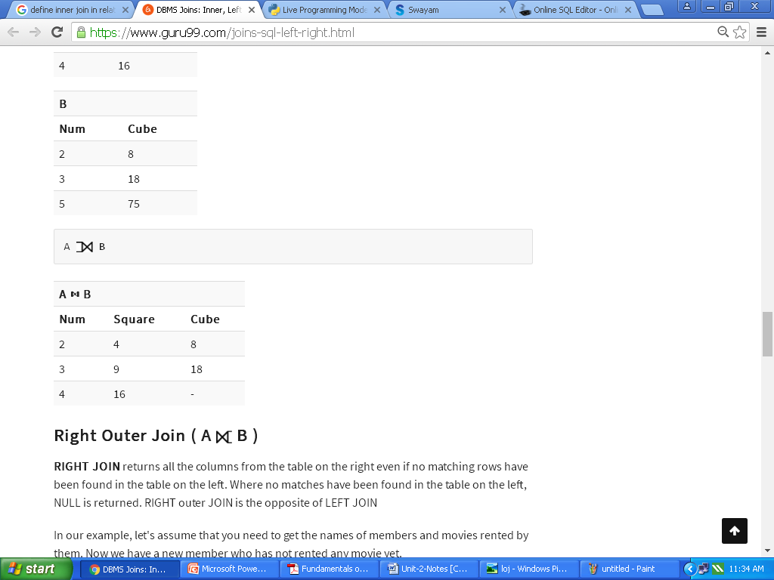
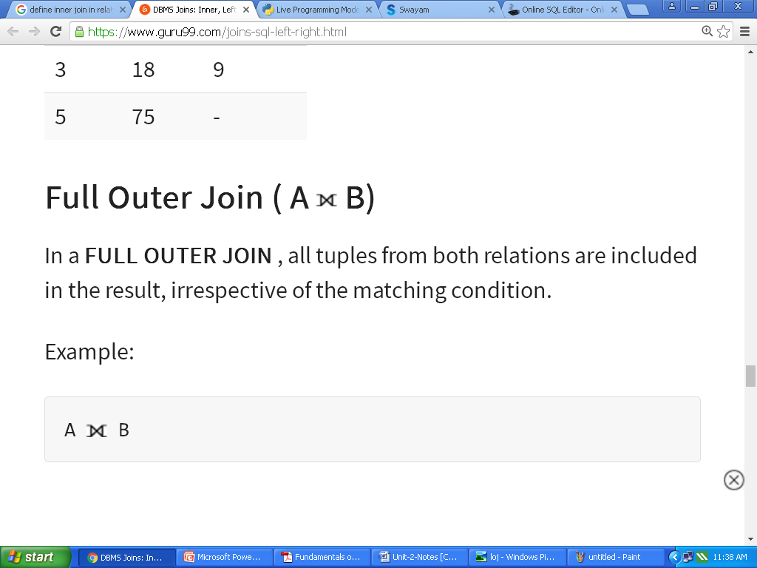
Binary Relational Operations:
JOIN and DIVISION
OUTER JOIN : LEFT OUTER JOIN, RIGHT OUTER JOIN & FULL OUTER JOIN
Left Outer Join (A B): This returns all the rows from the table on the left even if no matching rows have been found in the table on the right. When no matching record found in the table on the right, NULL is returned.
Right Outer Join ( A B ): This returns all the columns from the table on the right even if no matching rows have been found in the table on the left. Where no matches have been found in the table on the left, NULL is returned.
Full Outer Join ( A B): In a FULL OUTER JOIN , all tuples from both relations are included in the result, irrespective of the matching condition.

Slide 32
Binary Relational Operations:
Summary of JOIN operations:
There are mainly two types of joins in DBMS 1) Inner Join 2) Outer Join
An inner join is the widely used join operation and can be considered as a default join-type.
Inner Join is further divided into three subtypes: 1) Theta join 2) Natural join 3) EQUI join
Theta Join allows you to merge two tables based on the condition represented by theta
When a theta join uses only equivalence condition, it becomes an equi join.
Natural join does not utilize any of the comparison operators.
An outer join doesn't require each record in the two join tables to have a matching record.
Outer Join is further divided into three subtypes are: 1)Left Outer Join 2) Right Outer Join 3) Full Outer Join
The LEFT Outer Join returns all the rows from the table on the left, even if no matching rows have been found in the table on the right.
The RIGHT Outer Join returns all the columns from the table on the right, even if no matching rows have been found in the table on the left.
In a full outer join, all tuples from both relations are included in the result, irrespective of the matching condition.

Slide 33
Binary Relational Operations:
The DIVISION Operation : denoted by ÷, is useful for a special kind of query that
sometimes occurs in database applications.
An example is Retrieve the names of employees who work on all the projects that ‘John Smith’ works on. To express this query using the DIVISION operation, proceed as follows. First, retrieve the list of project numbers that ‘John Smith’ works on in the intermediate relation SMITH_PNOS:
Next, create a relation that includes a tuple <Pno, Essn> whenever the employee whose Ssn is Essn works on the project whose number is Pno in the intermediate relation SSN_PNOS:
Finally, apply the DIVISION operation to the two relations, which gives the desired employees’ Social Security numbers:

Slide 34
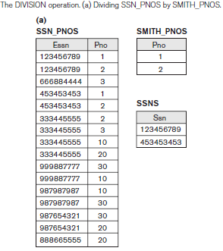
Binary Relational Operations:
The result is shown below:

Slide 35
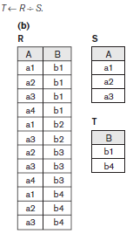
Binary Relational Operations:
In general, the DIVISION operation is applied to two relations R(Z) ÷ S(X), where the attributes of S are a subset of the attributes of R; that is, X ⊆ Z. For a tuple t to appear in the result T of the DIVISION, the values in t must appear in R in combination with every tuple in S. The DIVISION operation is defined for convenience for dealing with queries that involve universal quantification or the all condition.

Slide 36


Aggregate Functions and Grouping :
We can define an AGGREGATE FUNCTION operation, using the symbol ℑ (pronounced script F), to specify these types of requests as follows:
_{<grouping attributes>} ℑ _{<function list>} (R)
where <grouping attributes> is a list of attributes of the relation specified in R, and <function list> is a list of (<function> <attribute>) pairs. In each such pair, <function> is one of the allowed functions—such as SUM, AVERAGE, MAXIMUM, MINIMUM, COUNT—and <attribute> is an attribute of the relation specified by R. The resulting relation has the grouping attributes plus one attribute for each element in the function list. Eg:
1. ℑ _{COUNT Ssn, AVERAGE Salary}(EMPLOYEE)
2. ρR(Dno, No_of_employees, Average_sal)(_{Dno} ℑ _{COUNT Ssn, AVERAGE Salary} (EMPLOYEE)).

Slide 37


Examples of Queries in Relational Algebra
1. Retrieve the name and address of all employees who work for the ‘Research’ department.
2. For every project located in ‘Stafford’, list the project number, the controlling
department number, and the department manager’s last name, address, and birth date.

Slide 38


Examples of Queries in Relational Algebra
3. Find the names of employees who work on all the projects controlled
by department number 5.
4. Make a list of project numbers for projects that involve an employee
whose last name is ‘Smith’, either as a worker or as a manager of the department that controls the project.

Slide 39


Examples of Queries in Relational Algebra
5. List the names of all employees with two or more dependents.
Strictly speaking, this query cannot be done in the basic (original) relational
algebra. We have to use the AGGREGATE FUNCTION operation with the COUNT
aggregate function. We assume that dependents of the same employee have
distinct Dependent_name values.
6. Retrieve the names of employees who have no dependents.
This is an example of the type of query that uses the MINUS (SET DIFFERENCE)
operation.

Slide 40

Examples of Queries in Relational Algebra
7. List the names of managers who have at least one dependent.
In this query, we retrieve the Ssns of managers in MGRS, and the Ssns of employees with at least one dependent in EMPS_WITH_DEPS, then we apply the SET INTERSECTION operation to get the Ssns of managers who have at least one dependent.

